Slide 1

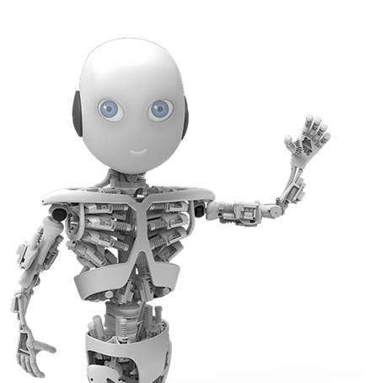

Practical Bayesian Optimization of Machine Learning Algorithms
Trabelsi oussema | Solofo Rabonarijaona
L3 info
Professeur : frédéric-hache

Slide 2
Summary:
1-Machine Learning introduction
2-
3-
…

Slide 3
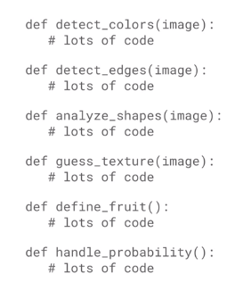
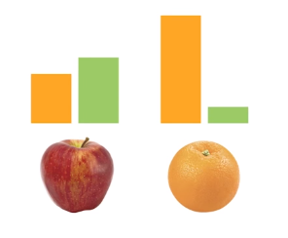
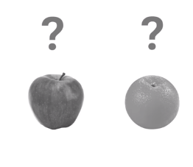
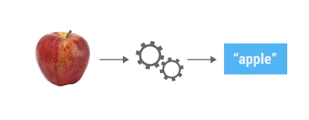
Machine Learning introduction
What’s the ML?

Slide 4
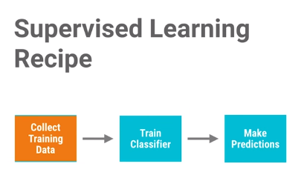
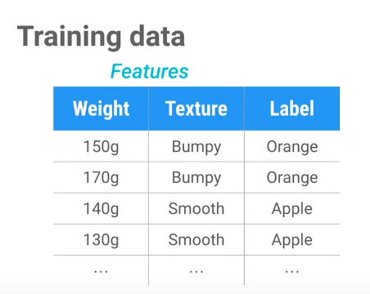
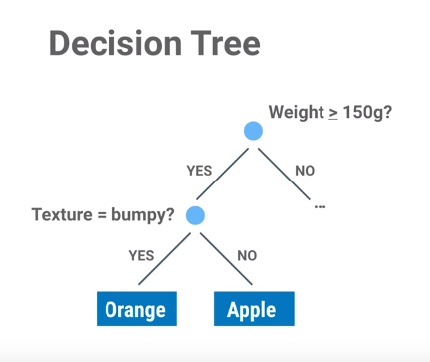
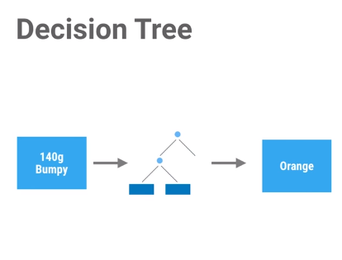

Slide 5
parameters vs hyperparameters

